Slide 1
Amazon Product Recommendation Engine
Capstone Project I

Slide 2
Problem Statement
The goal is to understand what products are famous among customers and recommend them more similar products and increase the sales percentage. Also, to reduce the customer churn, go through the reviews provided by customers for the products and reduce the concerns.

Slide 3
Data Cleaning
Duplicates -
Though it seems there are many duplicates, there are no repeated reviews each review is unique for different products by a customer.
Missing Data –
Only reviewText and sumary has missing values which are 24 and 1 respectively. As summary can be considered as minimal version of reviewtext. we can ignore the reviewText as we will be dropping the column going forward. And, summary has only 1 missing value which can be ingnored.

Slide 4
Data Selection
Selecting only the products with more than 100 reviews for better results. As any products with less than 100 reviews might not be very popular and there is no need of recommending those products.
Single product might have received many reviews by different customers. Hence, grouping all the summary Reviews by product ID.

Slide 5
Text Cleaning
Clean the reviews_summary column data by removing blank spaces and converting all the data into lower case.
Drop the duplicate rows and reset the index.
Using the CountVectorizer method to tokenize the data and build a vocabulary of known words.

Slide 6
Modelling
Using KNN(K Nearest Neighbor) find the similar products
kNN with k = 3, Algorithm = ball_tree
Based on product reviews, for B0051U15E4 average rating is 4.412280701754386
The first similar product is B003YBHF82 average rating is 4.21
The second similar product is B000FH4JJQ average rating is 4.536363636363636
Predicting reviews with 85, 15 train, test split and k = 5
Based on product reviews, for B00DQYNS3I average rating is 4.526315789473684
The first similar product is B003YBHF82 average rating is 4.21
The second similar product is B000FH4JJQ average rating is 4.536363636363636

Slide 7
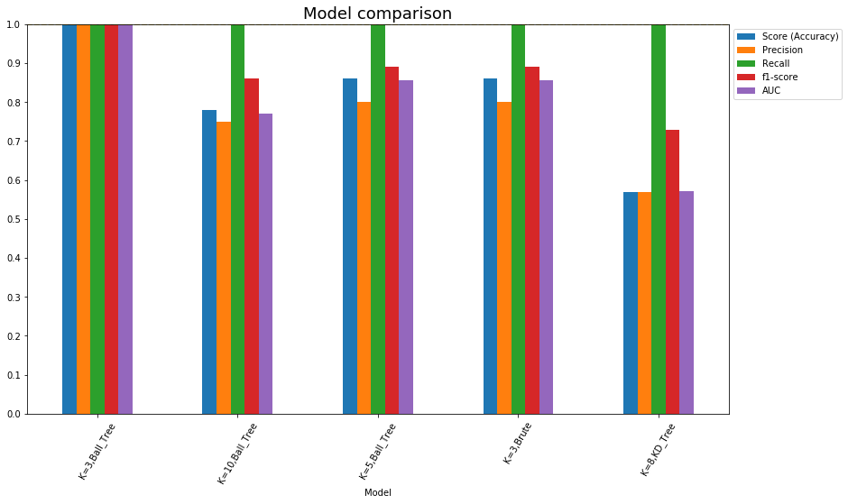
Models comparison Results

Slide 8
Sentimental Analysis
To understand how customers are feeling about the products, sentimental analysis is performed using the reviews given by customers for the products.

Slide 9
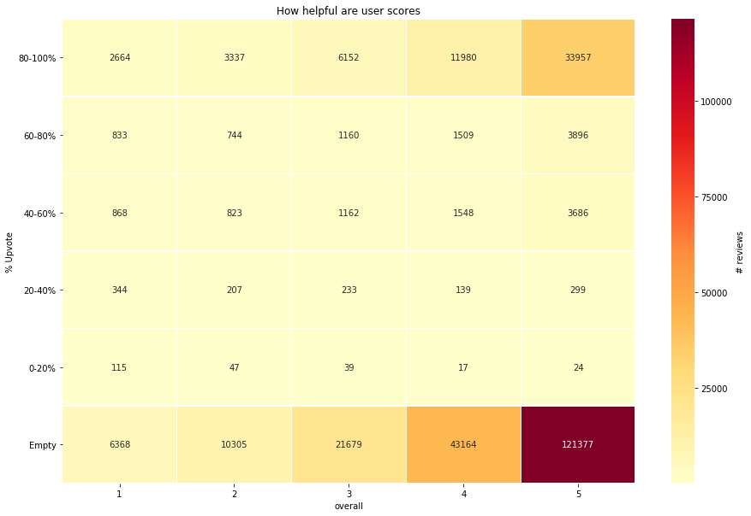
How useful are the user reviews

Slide 10
Modelling
Performing logistic regression on word count.
# features: 73968
# train records: 186189
# test records: 62063
Model Accuracy: 0.9370639511464157
It is observed that the few words with highest positive and negative coefficient doesn't make sense such as (complaint - 1.836577, worried - 1.806284, goodwill - -2.294153).

Slide 11
Baseline accuracy of the model is as follows:
# features: 73968
# train records: 186189
# test records: 62063
Model Accuracy: 0.8101445305576591
TF-IDF vectorizer is added to logistic regression to improve the model accuracy
# features: 73968
# train records: 186189
# test records: 62063
Model Accuracy: 0.9383046259446047
Accuracy with tf-idf has increased from 81% to 93.8%. It can also be observed that words that don't indicate polarity of the sentiment are removed.

Slide 12
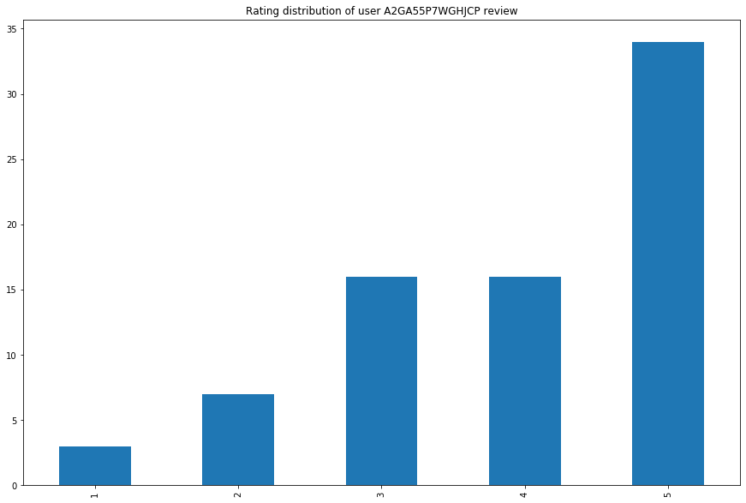
Study of the user behavior
It can be observed that the user is liked of most of the products.

